Slide 1
Log File Analysis & Reporting System

Slide 2
Content
Project Overview
Project Goal
Core Feature Implemented
Technology
Architecture
Project Structure
MySql Integeration
Database Schema
Python Cli Workflow
Configuration Requirements

Slide 3
Project Overview
Develop a CLI tool to ingest, process, and analyze web server log files. It should read large files, extract structured data, persist it in MySQL, and offer commands for querying and reporting on web traffic, user behavior, and server performance.

Slide 4
Project Goals
Process and analyze web server logs using a CLI tool
Store structured data in MySQL and generate reports
Enable quick insights into traffic, status codes, and user behavior

Slide 5
Core Features Implemented
Log parsing (Apache Common Log Format)
Normalized MySQL schema with user_agents & log_entries
Argparse-based CLI with processing & reporting commands

Slide 6
Technology
Python
Mysql
Python Libraries
Log Format (ACLF the typical format web server access)

Slide 7
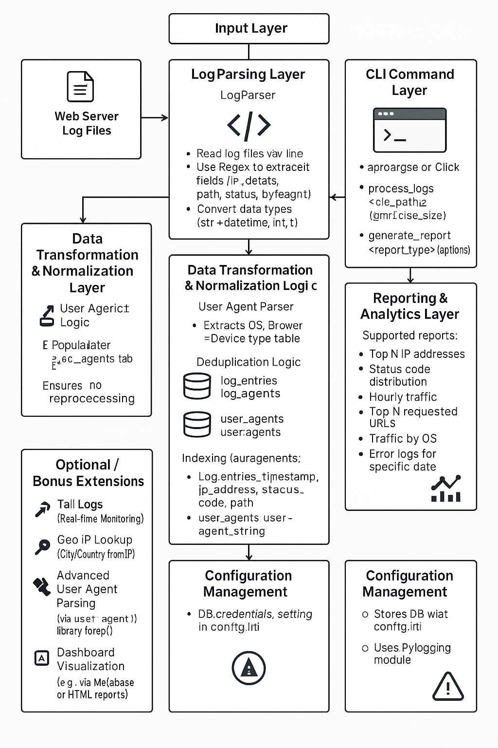
Architecture

Slide 8
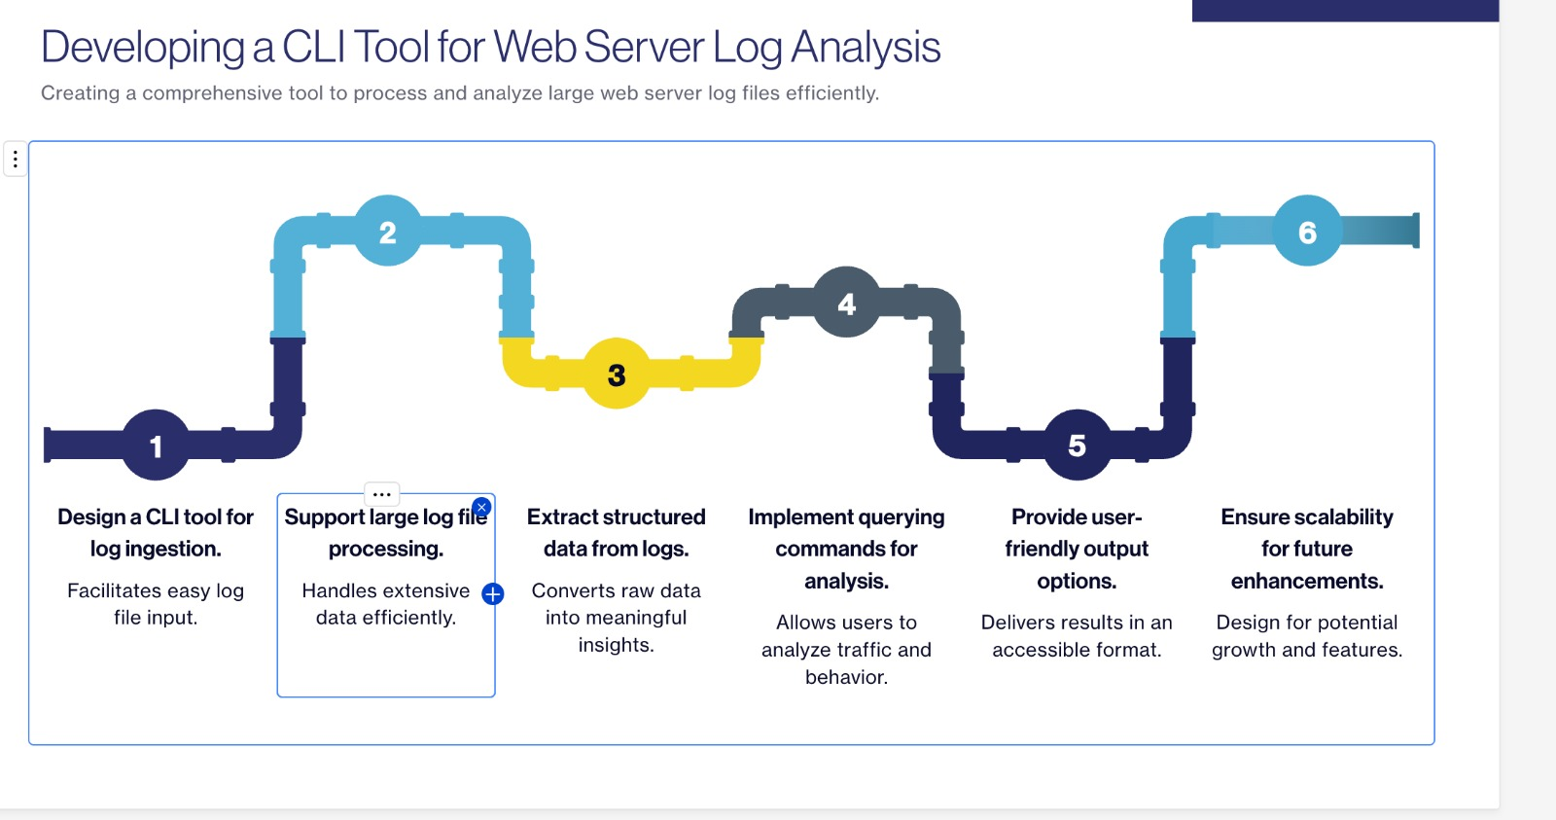

Slide 9
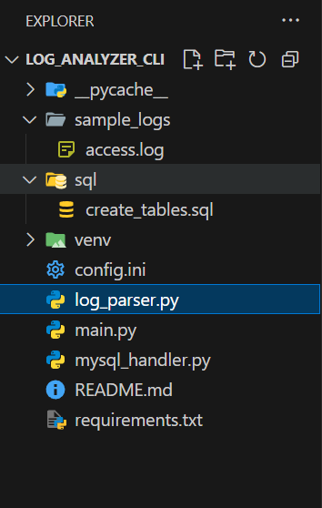
Project Structure
main.py, log_parser.py, mysql_handler.py — core logic
sql/create_tables.sql — schema definitions
sample_logs/access.log — sample data for testing

Slide 10
MySQL Workbench Integration
SQL compatible with Workbench: CREATE DATABASE + tables
Use GUI to execute schema creation and verify structure
Supports visual confirmation of schema relationships

Slide 11
Python CLI Workflow
process_logs — Parse and load Apache logs in batch DB
generate_report — View top IPs, HTTP status stats, traffic
Output presented as formatted CLI tables via tabulate

Slide 12
Database Schema Overview
user_agents: UA string, OS, browser, device
log_entries: IP, timestamp, method, status, referrer
Linked via foreign key (user_agent_id)

Slide 13
Configuration & Requirements
config.ini: DB credentials (host, user, password)
requirements.txt: mysql-connector-python, tabulate
Python 3.10+ environment with venv activated

Slide 14
Running the App
Create DB & tables in Workbench (run create_tables.sql)
Run: python main.py process_logs sample_logs/access.log --batch_size 500
Run: python main.py generate_report top_n_ips –-n 5
Run: python main.py generate_report status_code_distribution
Run: python main.py generate_report hourly_traffic

Slide 15
Data for Testing
4 user agents inserted with varied OS/browser/device
5 log entries: mix of GET/POST, status codes (200, 404, 500)
Validated with SQL SELECT joining both tables

Slide 16
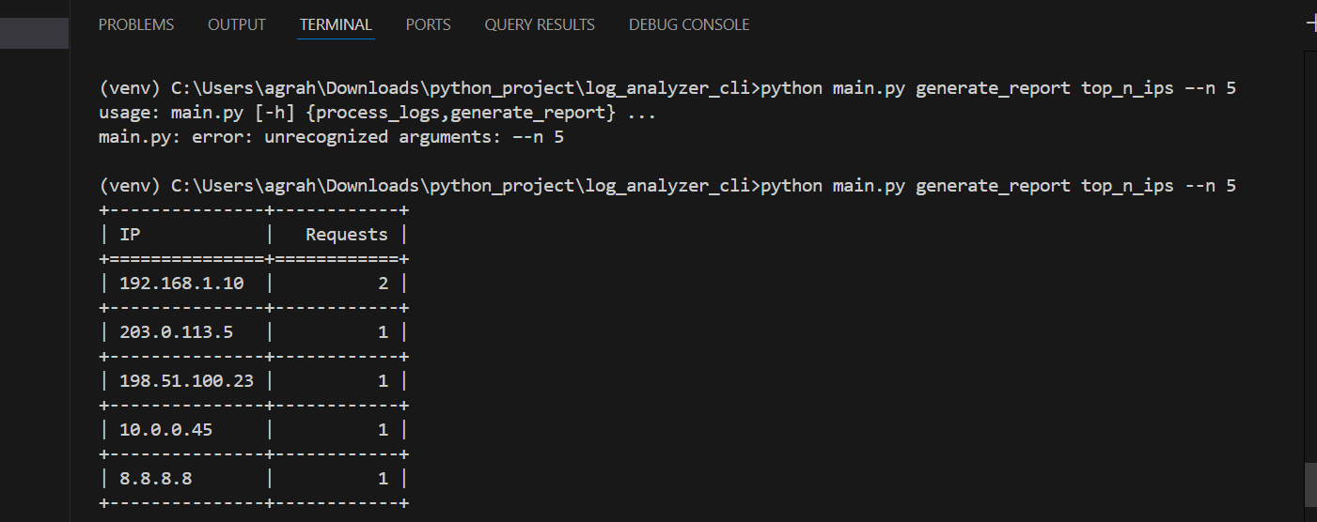
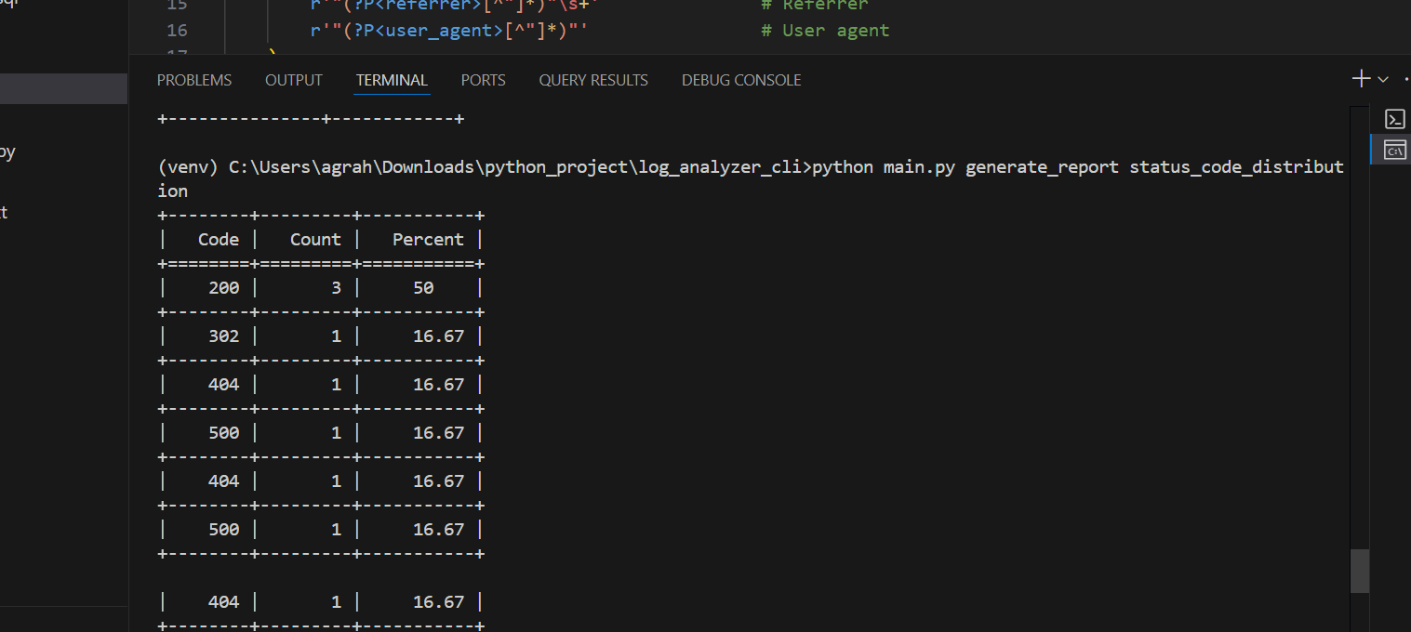
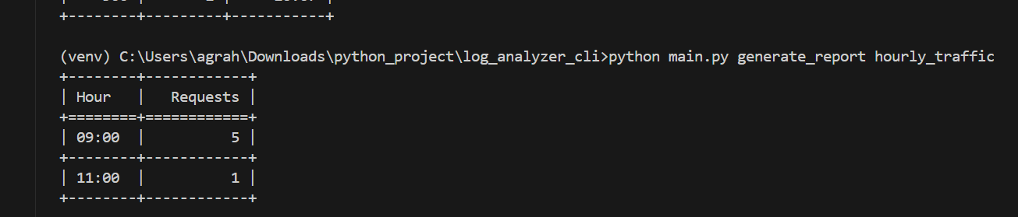
Output

Slide 17
Learning Object
Data Parsing-: Master parsing semi-structured text data using regular expressions.
Database Design-: Design and implement an optimized relational database schema for log data.
Database Management-: Efficiently load and manage large volumes of data in MySQL.
Advanced SQL-: Develop advanced SQL queries for data aggregation and trend analysis.
CLI Development-:Build a robust and user-friendly command-line interface.

Slide 18
Conclusion & Next Steps
Fully functional CLI log analysis tool
Compatible with MySQL Workbench & real-world logs
Can be extended with dashboards, geolocation, ML alerts

